Slide 1
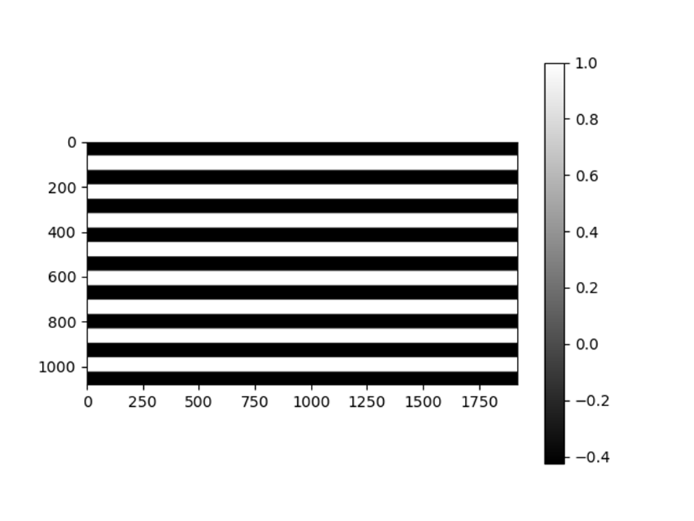
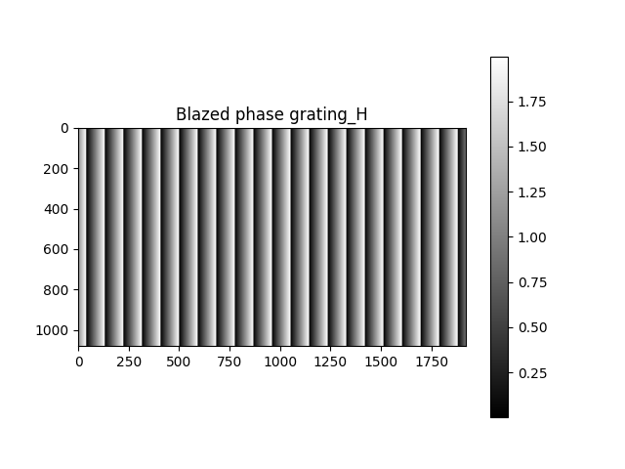
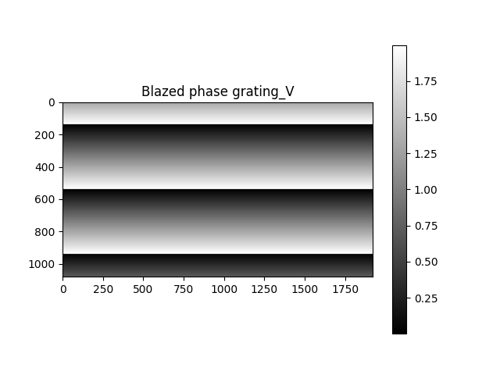

Simulation FFT of binary phase grating with/ without blazed phase gratings. 1 One channel
Size 1920*1080
Binary phase grating
Phase1=exp(i*0)
Phase2=exp(i*0.64*π)
Blazed phase grating (horizontal)
Phase=exp(i*(0-2 π))
Blazed phase grating (vertical)
Phase=exp(i*(0-2 π))
In the simulation
FFT of binary phase grating is calculated.
FFT of Blazed phase grating (horizontal) × Blazed phase grating (vertical).
FFT of binary phase grating × blazed phase grating (horizontal) × blazed phase grating (vertical).
FFT of Gaussian beam × binary phase grating × blazed phase grating (horizontal) × blazed phase grating (vertical) to observe diffraction pattern clearly.
Gaussian Beam
Size 1920*1080
Beam width= 150px

Slide 2


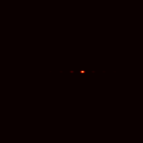




2. Simulation results of blazed phase gratings
FFT of Gaussian Beam × blazed phase grating
In calculation full size is used, for showing it the size is 200*200.
$p=$ $128px$
×
1.5π
1.85π
2π
2.5π
I_0= 0.005 I_1= 0.985
I_0=0
I_1= 1
I_0= 0.034 I_1= 0.797
I_2=0.098
I_0= 0.085
I_1= 0.818

Slide 3

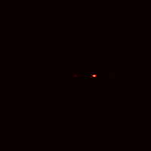
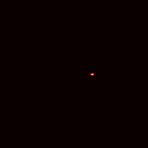
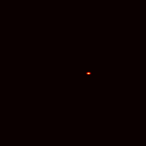
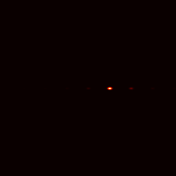

2. Simulation results of blazed phase gratings
FFT of Gaussian Beam × blazed phase grating
In calculation full size is used, for showing it the size is 200*200.
$p=$ $79px$
×
1.5π
1.85π
2π
2.5π
I_0= 0.004 I_1= 0.723
I_0= 0.0004 I_1= 0.73
I_0= 0.037 I_1= 0.57
I_2=0.057
I_0= 0.08 I_1= 0.606

Slide 4








3. Simulation results of binary phase gratings
$w=$ $350px$
$p=$ $128px$
FFT of Gaussian Beam × binary phase grating
Size 100*240
To see tri clearly.
I_0=0.289
I_1=0.159
I_-1=0.159
×
$p=$ $79px$
$p=$ $400px$
×

Slide 5





3. Simulation results of binary phase gratings
$w=$ $350px$
$p=$ $108px$
FFT of Gaussian Beam × binary phase grating
Size 100*240
To see tri clearly.
I_0=0.287
I_1=0.289
I_-1=0.289
×
×
I_0=0.005
I_1=0.731

Slide 6


3. Simulation results of binary phase gratings
$w=$ $350px$
$p=$ $96px$
FFT of Gaussian Beam × binary phase grating
Size 100*240
To see tri clearly.
I_0=0.287
I_1=0.237
I_-1=0.237
×
I_0=0
I_1=0.954

Slide 7







$p=$ $19px$
$p=$ $101px$
$p=$ $7px$
$p=$ $139px$
$p=$ $213px$
$p=$ $9px$
$p=$ $479px$
reminder=1
I_0=0
I_1=0.964
I_-2=0
reminder=1
I_0=0
I_1=0.999
I_-2=0
reminder=2
I_0=0
I_1=0.524
I_-2=0
reminder=2
I_0=0.0001
I_1=0.898
I_-2=0
reminder=3
I_0=0
I_1=0.998
I_-2=0
reminder=3
I_0=0
I_1=0.497
I_-2=0
reminder=4
I_0=0
I_1=1
I_-2=0

